Slide 1

CREATIVE COMPANY
2020

Slide 2

Introducing
Welcome
Suitable for all categories business and personal presentation farmers ensure that we will bring the best of the market to your kimquae ab illo inventore veritatis et. Suitable for all categories business and personal presentation farmers.
Subtitle iDea here
Adam Doe
Graphic Designer

Slide 3



iDea
Subtitle iDea here
About iDea
Suitable for all categories business and personal presentation farmers ensure that we will bring the best of the market to your kimquae ab illo inventore veritatis et.
Join Us
“Try hard and creative hard and try again”

Slide 4
Paragraf
Subtitle iDea here
First Paragraf
Suitable for all categories business and personal presentation farmers ensure that we will bring the best of the market to your kimquae ab illo inventore veritatis et. Suitable for all categories business and personal presentation farmers ensure that we will bring the best of the market to your kimquae ab illo inventore veritatis etmall categories business and personal presentation farmers ensure that we will bring the best of the market to your kimquae ab illo inventore
veritatis et. Suitable for all categories business and personal presentation farmers ensure that we will bring the best of the market to your kimquae ab illo inventore veritatis etm
Suitable for all categories business and personal presentation farmers ensure that we will bring the best of the market to your kimquae ab illo inventore veritatis et. Veritatis et. Suitable for all categories business and personal presentatio
Suitable for all categories business and personal presentation farmers ensure that we will bring the best of the market to your kimquae ab illo inventore veritatis etmall categories business.
Second Paragraf
www.companyshop.com

Slide 5
Services
Subtitle iDea here
Communicate
To do list
Databases
Suitable for all categories business and personal presentation farmers ensure that we will bring
Suitable for all categories business and personal presentation farmers ensure that we will bring
Suitable for all categories business and personal presentation farmers ensure that we will bring
Get it
Get it
Get it

Slide 6

Vision & Missions
Subtitle iDea here
Vision
Missions
Suitable for all categories business and personal presentation farmers ensure that we will bring the best of the market to your kimquae ab illo inventore veritatis et.
Suitable for all categories business and personal presentation farmers ensure that we will bring the best of the market to your
Suitable for all categories business and personal presentation farmer.
“Try hard and creative hard and try again”
Suitable for all categories business.
Suitable for all categories business and personal presentation farmers ensure that.

Slide 7
Purpose
Subtitle iDea here
Inspiration
Suitable for all categories business and personal presentation farmers ensure
01.
Suitable for all categories business and personal presentation.
Suitable for all categories business and personal presentation farmer.
02.
Suitable for all categories business and personal presentation.
Suitable for all categories business.
Suitable for all categories business and personal presentation farmers ensure that.
03.
Suitable for all categories business and personal presentation.

Slide 8
Task List
Subtitle iDea here
Important
Suitable for all categories business and personal presentation farmers ensure that we will bring the best of the market to your kimquae ab illo inventore veritatis et.
Suitable for all categories business and
Suitable for all categories business and
Suitable for all categories business and
Suitable for all categories
Suitable for all categories
Suitable for all categories
Suitable for all categories business and personal presentation farmers
Suitable for all categories business and personal presentation farmers
Suitable for all categories business and personal presentation farmers
Suitable for all categories business
Suitable for all categories business and personal presentation farmers ensure that.

Slide 9

Awesome Team

Slide 10

Alicia Clara
Illustrator
Slly Renita
Graphic Designer
Setaphan Houl
Graphic Designer
Amanda Louis
Creative Direcctor
Paul Embarasing
Creative Direcctor

Slide 11




Creative Team
Subtitle iDea here
Sammuael El
Paul michigan
Suitable for all categories business and personal
Suitable for all categories business and personal
Yoana Cross
Selly Romanov
Suitable for all categories business and personal
Suitable for all categories business and personal

Slide 12
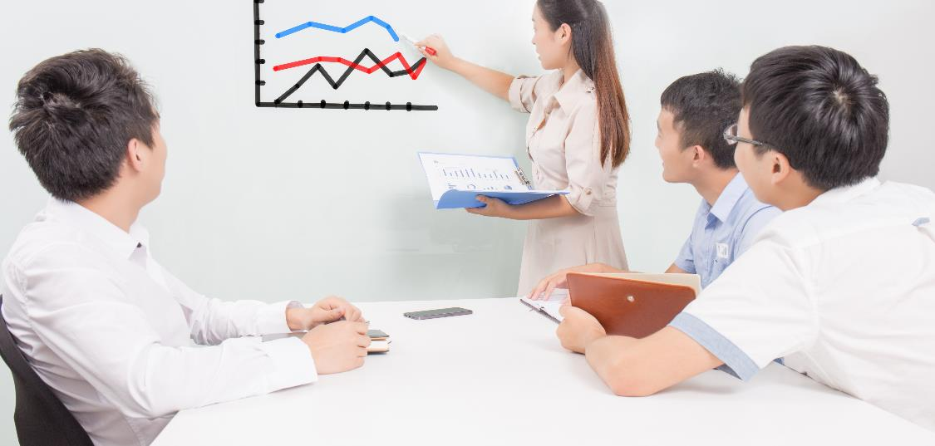
Inovative
Creative
Cool
Inspiration
P O R T F O L I O
http://www.companyshop.com

Slide 13

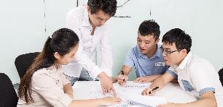




Portfolio
Subtitle iDea here
Inovative
Creative
Cool
Inspiration

Slide 14

Portfolio
Subtitle iDea here
Icon
Icon
Icon
Icon
Icon
Suitable for all categories
Suitable for all categories
Suitable for all categories
Suitable for all categories
Suitable for all categories

Slide 15




Portfolio
Subtitle iDea here
Great Work
Suitable for all categories business and personal presentation farmers ensure that we will bring the best of the market to your kimquae ab illo inventore veritatis et.
Smartphone
Suitable for all categories business and personal
Notebook
Suitable for all categories business
Tablet
Suitable for all categories business and personal presentation farmers ensure that we will

Slide 16

Portfolio
Subtitle iDea here
Company
Office
Creative Desk
Studio
Playground
Suitable for all categories business and personal presentation farmers ensure that we will

Slide 17



Mockup
Subtitle iDea here
It would appear that we have reached the limits of what it is possible to achieve with computer technology.
Suitable for all categories business and personal presentation farmers ensure that we will bring the best of the market to your kimquae ab illo inventore veritatis et.

Slide 18


Mockup
Subtitle iDea here
Notebook
Suitable for all categories business and personal presentation farmers ensure that we will bring the best of the market to your kimquae ab illo inventore veritatis et.
Battery
Monitor

Slide 19





Smartwatch
Subtitle iDea here
Smartwatch
On Desk
Suitable for all categories business and personal presentation farmers ensure that we will bring the best of the market
Suitable for all categories business
Share other device
4.365
Suitable for all categories business
Users
Outdoor
Suitable for all categories business and personal presentation
Suitable for all categories business

Slide 20
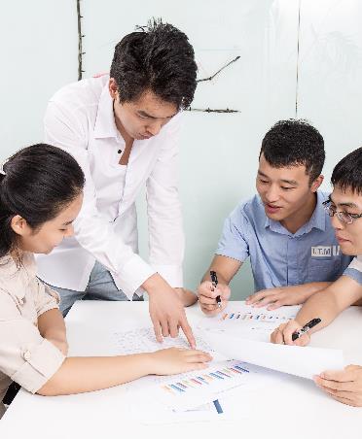
ANALYSIS
Subtitle iDea here
Strength
Suitable for all categories business and personal presentation farmers ensure that we will bring the best of the market to your kimquae ab illo inventore veritatis et.
S T R E N G T H
Progress
Limit
Suitable for all categories business and personal
Suitable for all categories business and personal
Check
Global Website

Slide 21

ANALYSIS
Subtitle iDea here
Weakness
Suitable for all categories business and personal presentation farmers ensure that we will bring the best of the market to your kimquae.
W E A K N E S S
Suitable for all categories business and
Suitable for all categories
Suitable for all categories business and personal
BAD

Slide 22

ANALYSIS
Subtitle iDea here
Opportunities
Suitable for all categories business and personal presentation farmers ensure that we will bring the best of the market to your kimquae.
O P P O R T U N I T I E S
01.
Chance
Suitable for all categories business and personal presentation farmers ensure that we
02.
Luck
Suitable for all categories business and personal presentation farmers

Slide 23
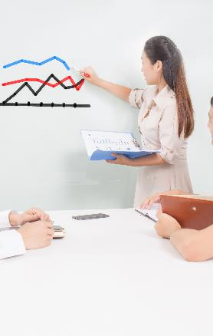
ANALYSIS
Subtitle iDea here
01.
Competitor
Suitable for all categories business and personal presentation farmers ensure that we will bring the best of the market to your kimquae ab illo inventore veritatis et.
T H R E A D
02.
Product
Suitable for all categories business and personal presentation farmers
03.
Price
Suitable for all categories business and personal presentation farmers ensure that we will bring the best of the market to your kimquae

Slide 24
World Map
Subtitle iDea here
American Map
Suitable for all categories business and personal presentation farmers ensure that we will bring the best of the market to your
Location 01
Location 02
Suitable for all categories business and
Suitable for all categories business and
Location 03
Location 04
Suitable for all categories business and
Suitable for all categories business and

Slide 25
3D Chart
Subtitle iDea here
Description
Suitable for all categories business and personal presentatio
Description
75%
Suitable for all categories business and personal presentatio
60%
Description
55%
Suitable for all categories business and personal presentatio
Description
Suitable for all categories business and personal presentatio
25%

Slide 26
Rocket Launcher
Subtitle iDea here
Description
Description
Suitable for all categories business and personal presentatio
Suitable for all categories business and personal presentatio
Description
Description
Suitable for all categories business and personal presentatio
Suitable for all categories business and personal presentatio
Description
Description
Suitable for all categories business and personal presentatio
Suitable for all categories business and personal presentatio

Slide 27
Work Desk
Subtitle iDea here
Description
Suitable for all categories business and personal presentation farmers ensure that we will bring the best of the market to your kimquae ab illo inventore veritatis et.
01.
02.
03.
Briefing
Suitable for all categories
Create Schedule
Suitable for all categories
Save in database
Suitable for all categories

Slide 28



Testimoni
Subtitle iDea here
Suitable for all categories business and personal presentation farmers ensure that we will bring the best of the market to your kimquae ab illo inventore veritatis et.
Adam Doe
Angela Purdy
Yoana Valais
Employee
Illustrator
Designer

Slide 29
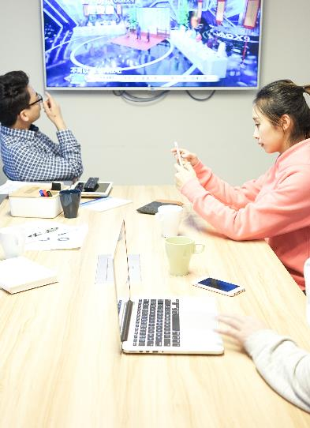
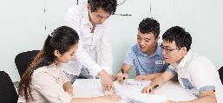

Location
Subtitle iDea here
Get in touch
Suitable for all categories business and personal presentation farmers ensure that we will bring the best of the market to your kimquae.
project@company.com
+76 869 – 8743 - 5432
project@company.com
Suitable for all categories business and personal Block C, No. 108 Netherland, AMsterdam

Slide 30
CREATIVE COMPANY
2020
THANK YOU
www. company.com

Slide 31
版权声明
感谢您下载千库网平台上提供的PPT作品，为了您和千库网以及原创作者的利益，请勿复制、传播、销售，否则将承担法律责任！千库网将对作品进行维权，按照传播下载次数进行十倍的索取赔偿！
1.在千库网出售的PPT模板是免版税类（RF：Royalty-Free）正版受《中国人民共和国著作法》和《世界版权公约》的保护，作品的所有权、版权和著作权归千库网所有，您下载的是PPT模板素材的使用权。
2.不得将千库网的PPT模板、PPT素材，本身用于再出售，或者出租、出借、转让、分销、发布或者作为礼物供他人使用，不得转授权、出卖、转让本协议或者本协议中的权利。
更多精品PPT模板：http://588ku.com/ppt/

